Slide 1
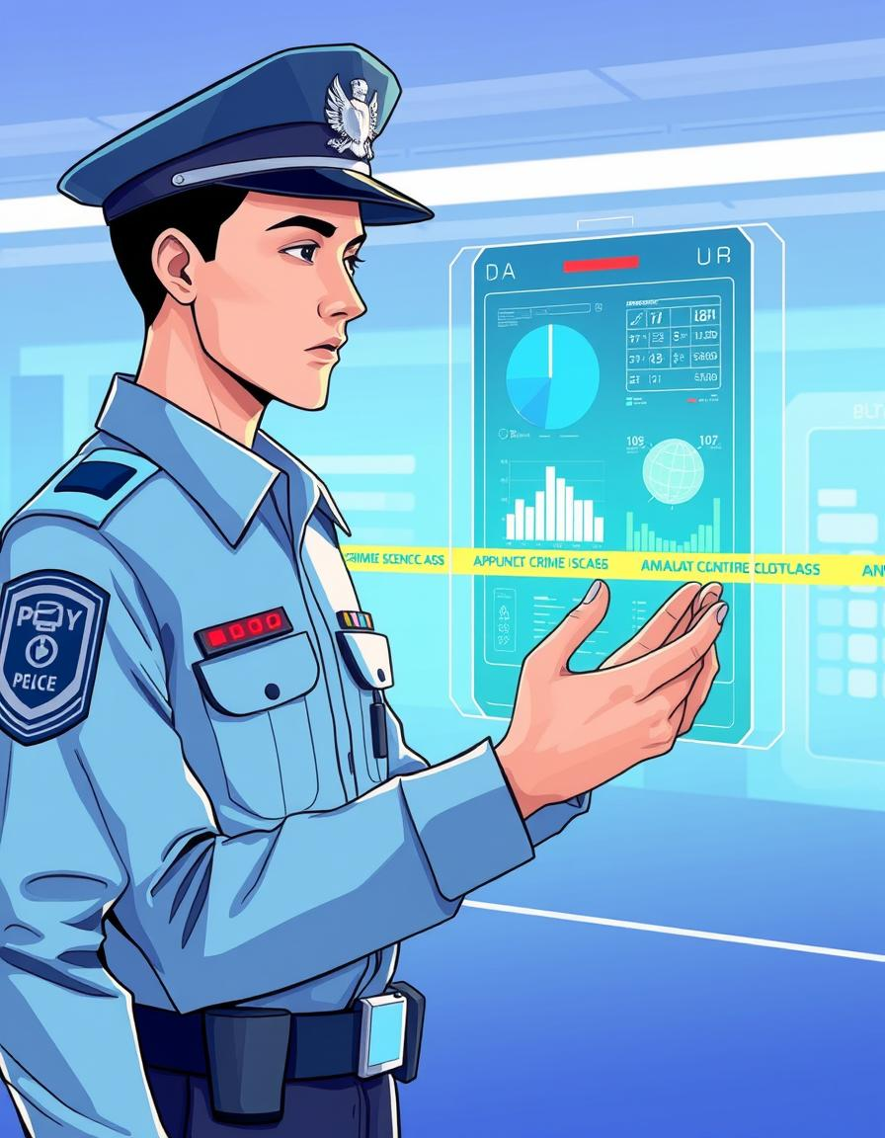
E-Police Connect System
Enhancing law enforcement capabilities through integrated digital solutions. This presentation outlines the E-Police Connect System.
Group members
1)Gillian Pereira(2502459200)​
2)Anurag Kamble(2502459200)​
3)Omkar Marne(2502459200)​
4)Om Kauthe(2502459200)

Slide 2
Introduction to E-Police Connect
This project, the E-Police Connectivity System, aims to provide a change on how police stations handle crucial data. Our system provides a platform for citizens to easily file complaints and track their status online. For designated police officers, it offers secure access to criminal records, prison records, and incident reports, ensuring all vital information is centrally managed and readily available. This digital approach enhances transparency, speeds up operations, and improves overall law enforcement capabilities within the region.​

Slide 3

Problem definition :
The police's ability to work effectively and combat crime depends on the quality of the information they can extract from their current records and how quickly they can obtain it.​
It is well understood that Crime Prevention, Detection and Conviction of criminals depend on a highly responsive backbone of Information Management​

Slide 4
System Requirements
Meeting these requirements ensures a reliable, secure, and efficient system for all law enforcement personnel.
Hardware Needs
Operating System (OS): Windows 10 Pro / Windows 11 Pro(64-bit)​
Storage: A 512GB SSD (Solid State Drive) is the minimum for fast boot times and application loading
A minimum of 8GB RAM is essential ​
Software Specifications
1)Use React 18.x​
2)Microsoft SQL Server (Database) 2022 ​
3).NET (Backend)​
initial deployment might require at least 4-8GB RAM for a small to medium database
can be deployed on AWS EC2​
Database Server: Can be on the same machine for small-scale;
consider dedicated DB instance for higher load​

Slide 5

Key Objectives
Centralized Information Management
Efficient Communication & Collaboration
Faster Complaint Registration
Digital Record Keeping
Transparency & Accountability
Improved Law Enforcement Efficiency
Enhance Public Trust

Slide 6
Core Features
Secure Access & Roles
Role-based login for Admin, Police Officers, and Citizens, ensuring data integrity.
Online FIR/Complaint
Citizens can easily register FIRs and complaints, streamlining the process.
Case Management
Officers can create, update, assign, and close case files digitally.
Crime Analytics
Visual reports and statistics for better crime analysis and resource allocation.
Action Logging
Comprehensive logs of all system actions for security and accountability.
Digital Criminal Database
Centralized profiles with arrest history, biometrics, and previous FIRs.

Slide 7
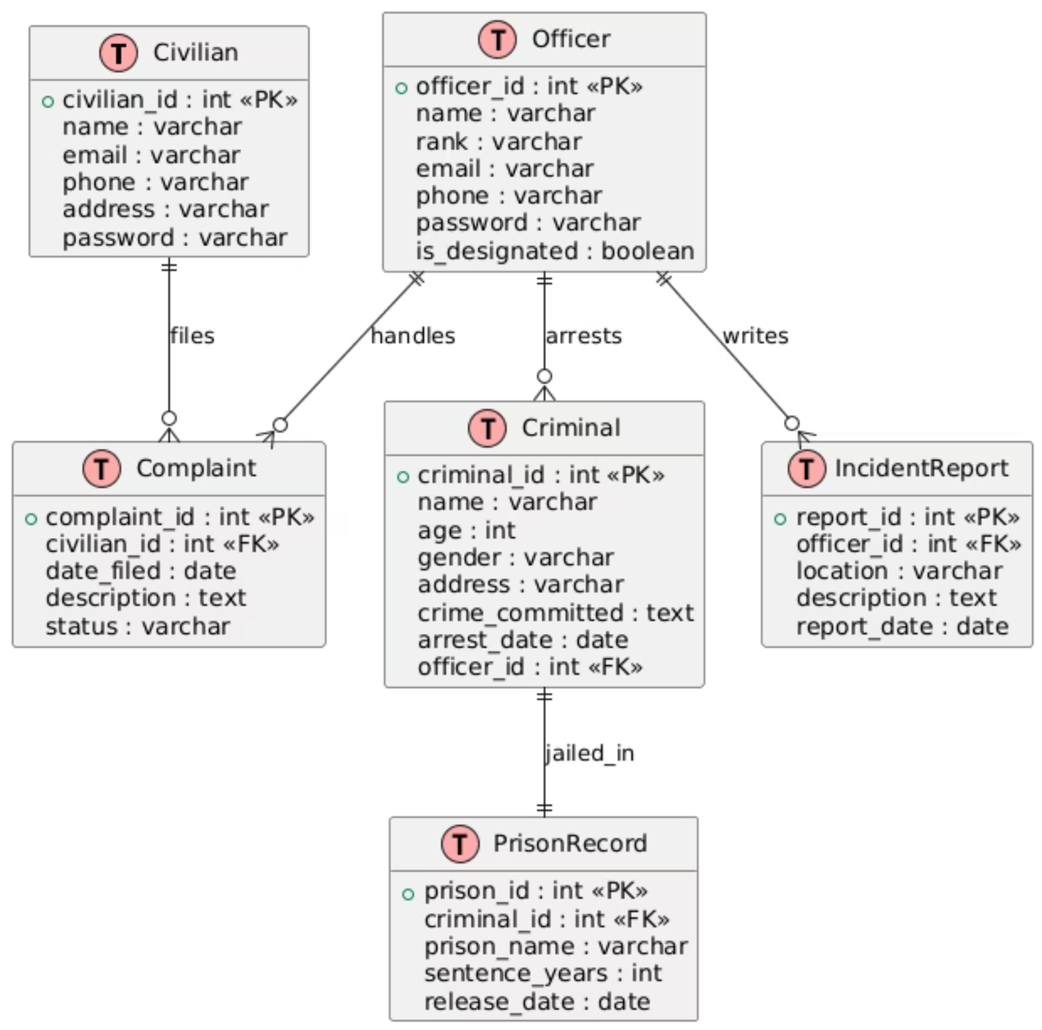
Entity-Relationship (ER) Diagram The ER Diagram details the crucial entities within the E-Police Connect database and their relationships, ensuring data integrity

Slide 8
User Interface of the Project
Home Page
Civilian Signup
Civilian Login
File a New Complaint
Police Login
Police Welcome Page
Complaints
Criminal Records
Prison Records

Slide 9
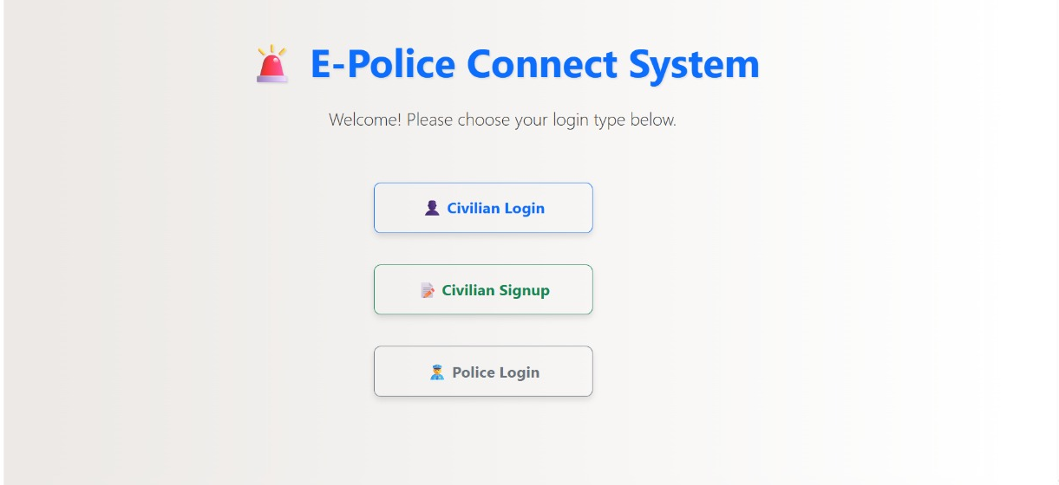
Home Page

Slide 10
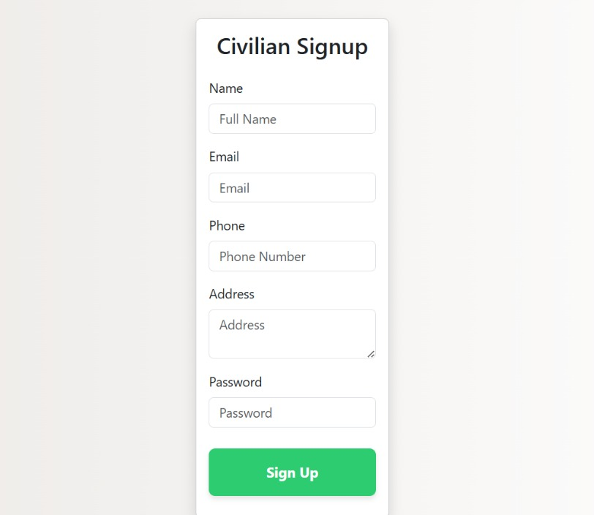
Civilian Signup

Slide 11
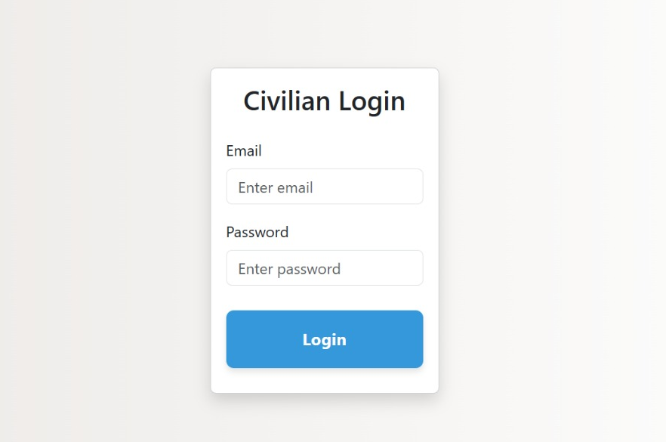
Civilian Login

Slide 12
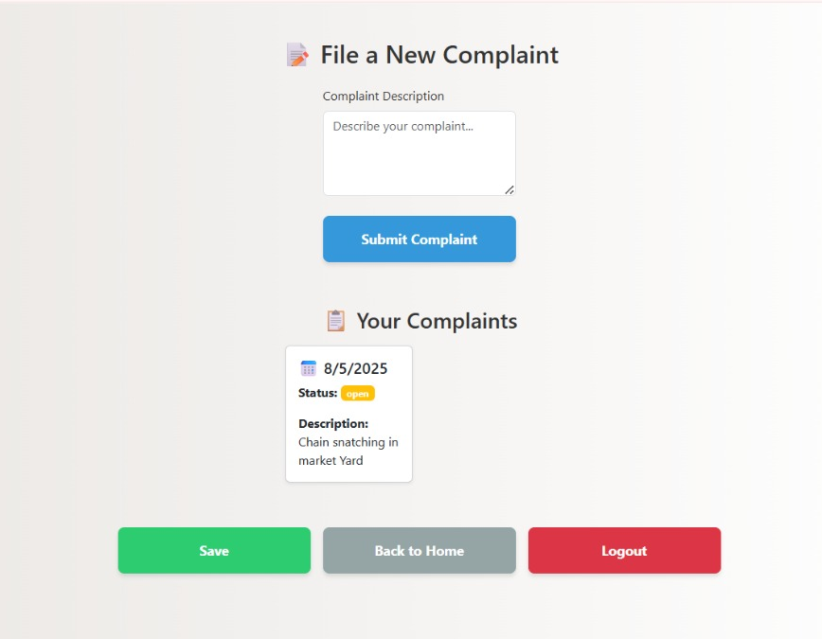
File a New Complaint

Slide 13
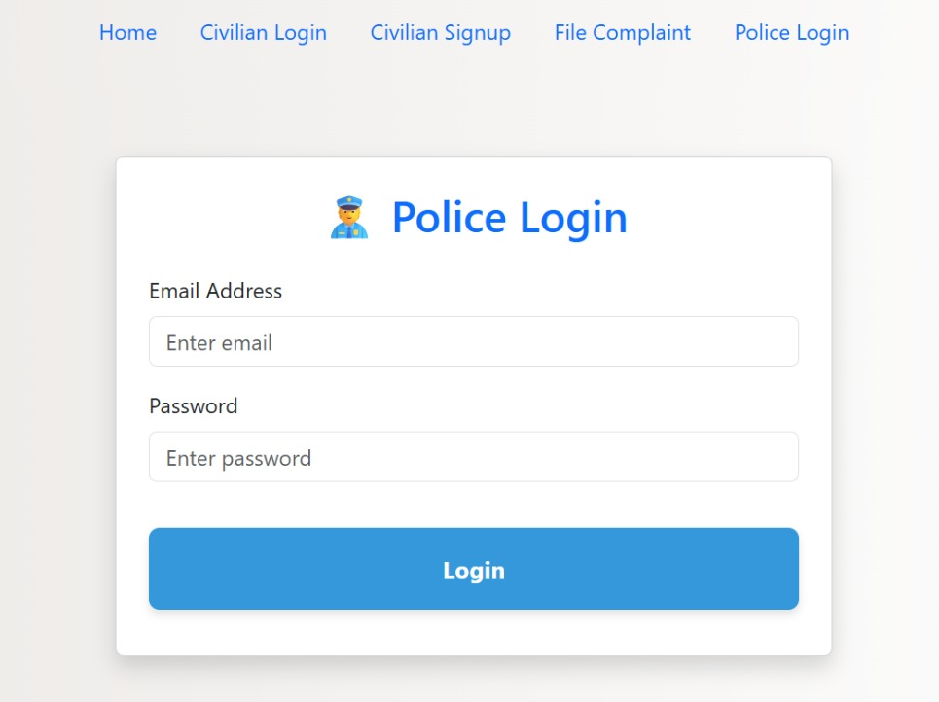
Police Login

Slide 14
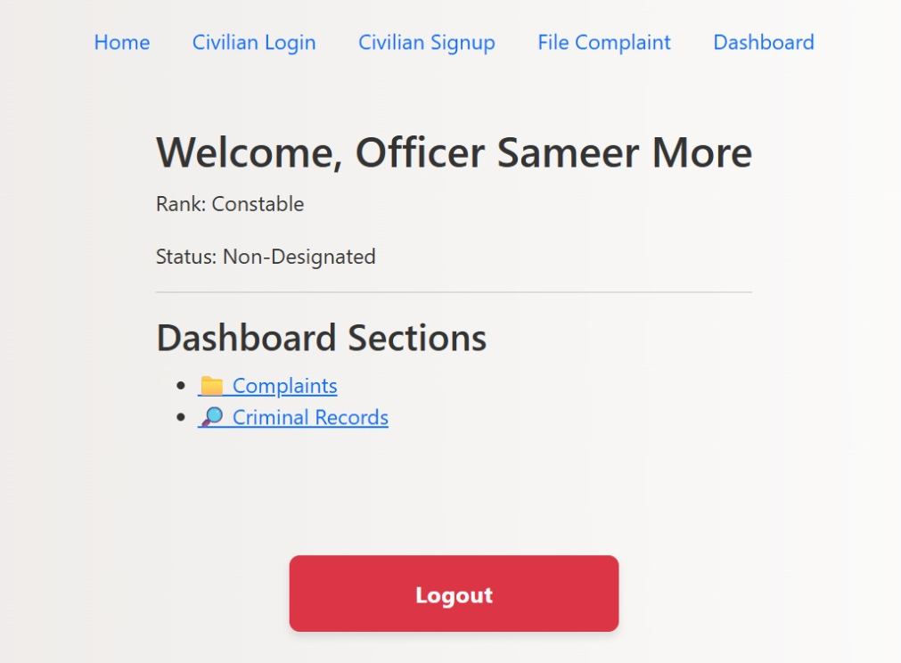
Police Welcome Page

Slide 15
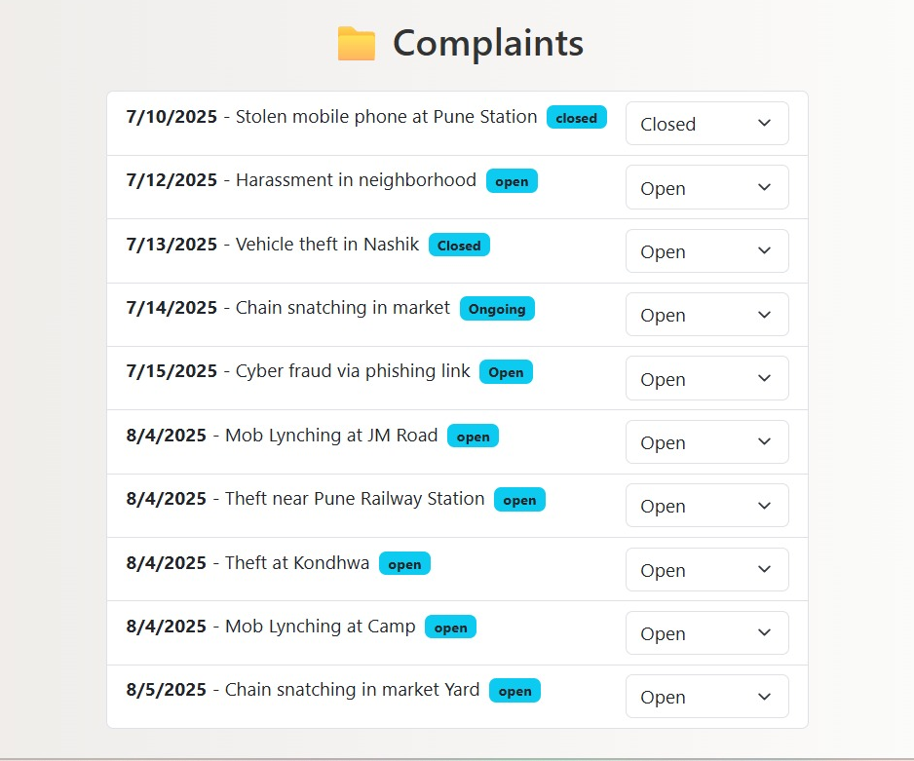
Complaints

Slide 16
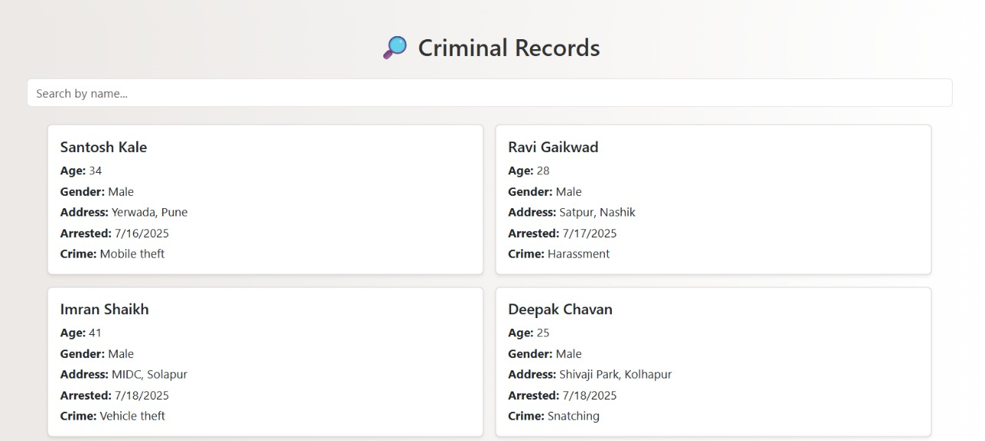
Criminal Records

Slide 17
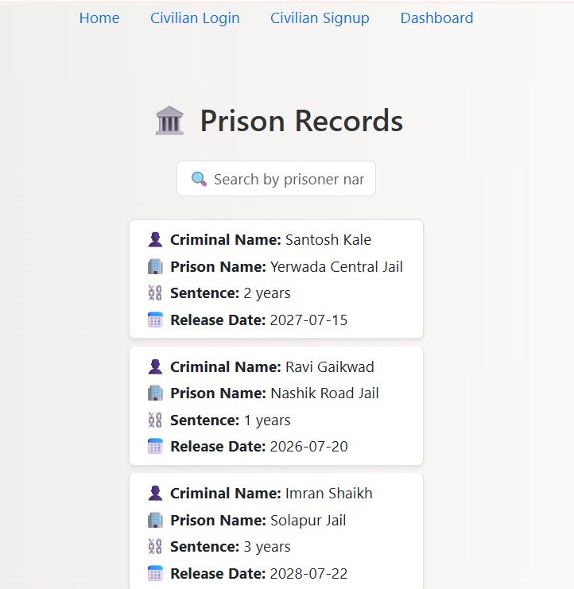
Prison Records

Slide 18


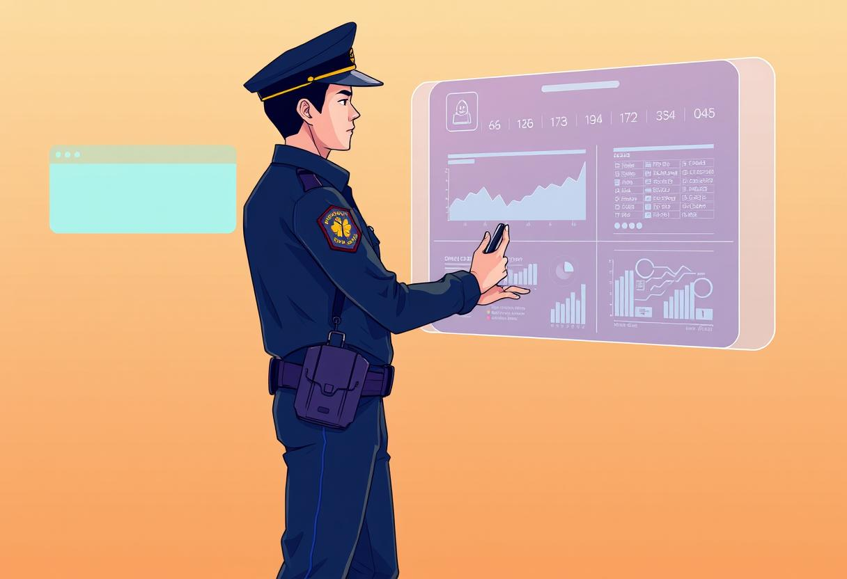
Conclusion & Future Vision
The E-Police Connect System is a robust step towards modernizing and digitizing the conventional policing process. By providing a centralized digital platform, it facilitates seamless interaction between citizens and law enforcement authorities, ensuring faster complaint registration, efficient case tracking, and transparent management of criminal records.
This system lays the foundation for a more responsive, accountable, and efficient law enforcement ecosystem, ultimately improving public safety and trust.

